Slide 1
Practitioner Questionnaire - Safeguarding Self-assessment 2021
Friday, January 14, 2022

Slide 2
562
Total Responses
Date Created: Friday, September 03, 2021
Complete Responses: 562

Slide 3
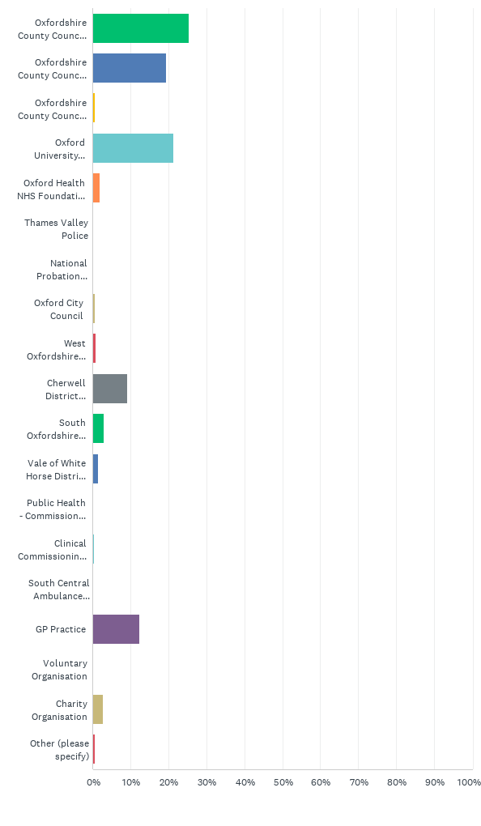
Q1: Which organisation do you belong to?
Answered: 562 Skipped: 0

Slide 4
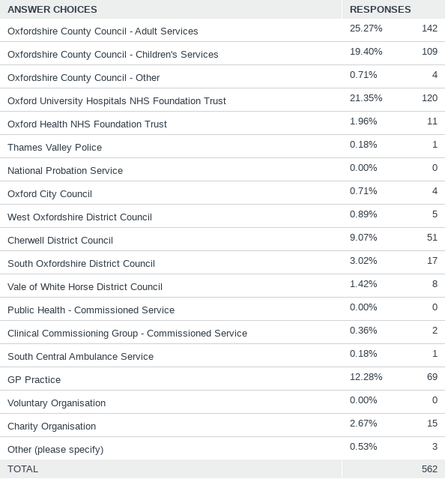
Q1: Which organisation do you belong to?
Answered: 562 Skipped: 0

Slide 5
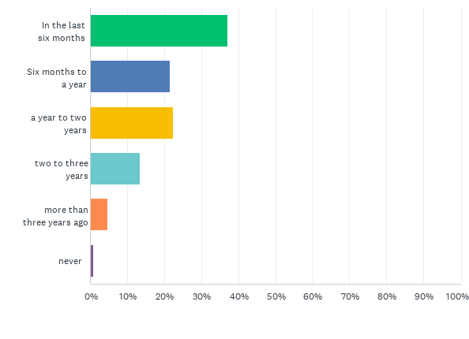
Q2: When did you last have safeguarding training?
Answered: 562 Skipped: 0

Slide 6
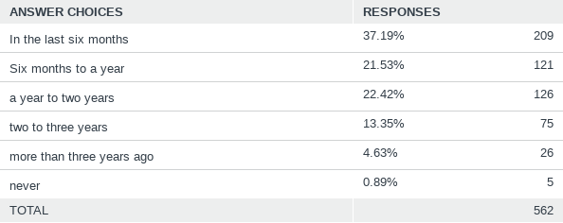
Q2: When did you last have safeguarding training?
Answered: 562 Skipped: 0

Slide 7
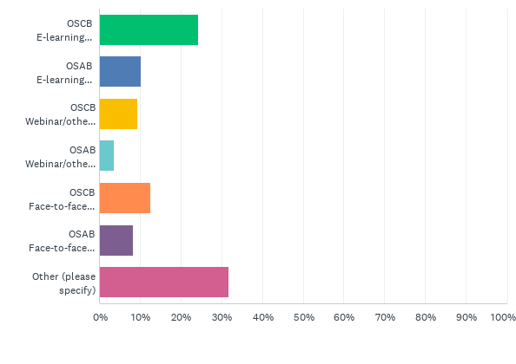
Q3: What format did the training take? Tick all that apply
Answered: 552 Skipped: 10

Slide 8
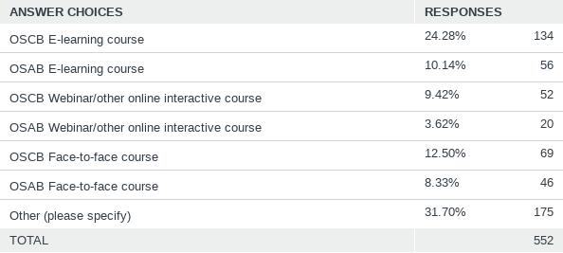
Q3: What format did the training take? Tick all that apply
Answered: 552 Skipped: 10

Slide 9
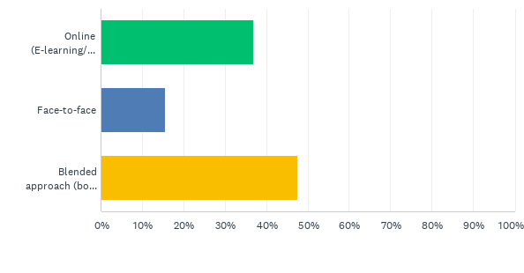
Q5: In future, how would you prefer your training to be delivered?
Answered: 559 Skipped: 3

Slide 10
Q5: In future, how would you prefer your training to be delivered?
Answered: 559 Skipped: 3

Slide 11
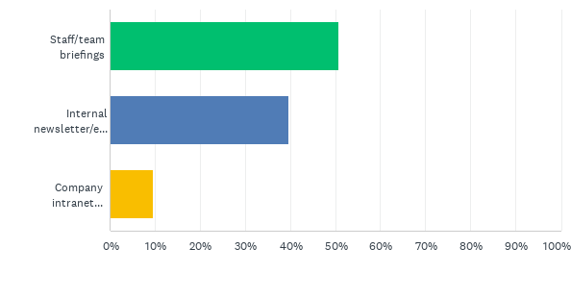
Q6: How does your organisation keep you up-to-date with safeguarding issues in Oxfordshire?
Answered: 530 Skipped: 32

Slide 12
Q6: How does your organisation keep you up-to-date with safeguarding issues in Oxfordshire?
Answered: 530 Skipped: 32

Slide 13
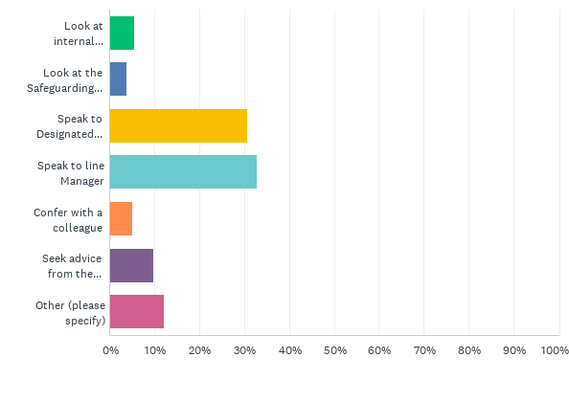
Q7: What do you do when you have safeguarding concerns about a a child or adult with care and support needs?
Answered: 532 Skipped: 30

Slide 14
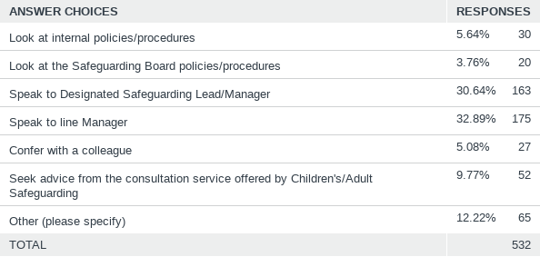
Q7: What do you do when you have safeguarding concerns about a a child or adult with care and support needs?
Answered: 532 Skipped: 30

Slide 15
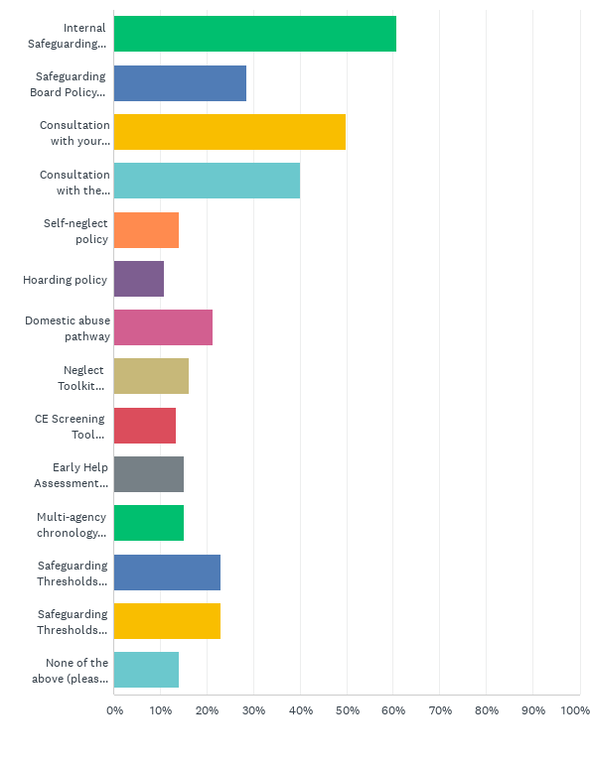
Q8: Which of the following tools have you used during any safeguarding work you have been involved in? Tick all that apply
Answered: 532 Skipped: 30

Slide 16
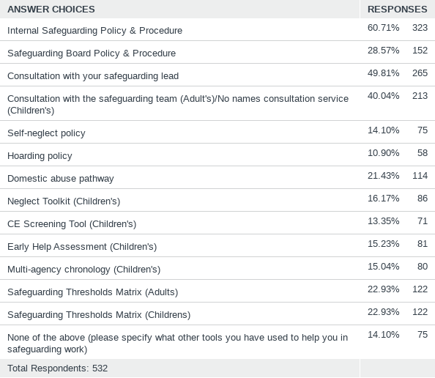
Q8: Which of the following tools have you used during any safeguarding work you have been involved in? Tick all that apply
Answered: 532 Skipped: 30

Slide 17
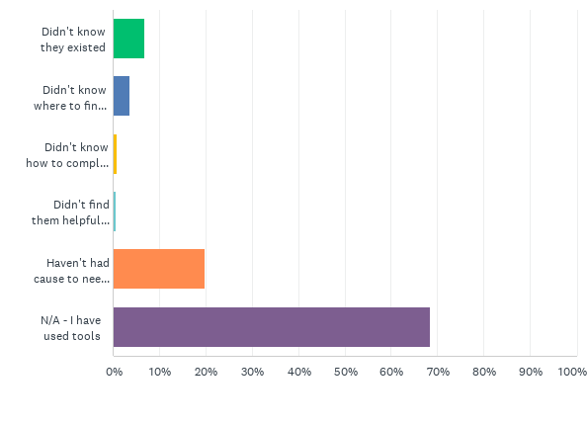
Q9: If you don't/haven't used any of the tools above, why not? What barriers were there to using them?
Answered: 532 Skipped: 30

Slide 18
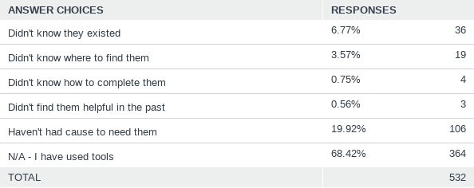
Q9: If you don't/haven't used any of the tools above, why not? What barriers were there to using them?
Answered: 532 Skipped: 30

Slide 19
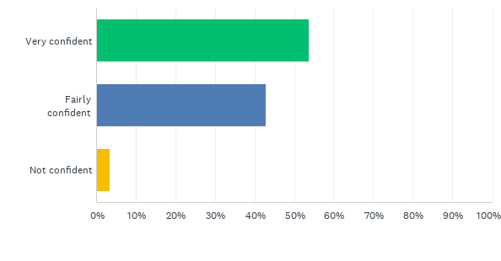
Q11: How confident do you feel asking if a child / family / adult needs any help?
Answered: 532 Skipped: 30

Slide 20
Q11: How confident do you feel asking if a child / family / adult needs any help?
Answered: 532 Skipped: 30

Slide 21
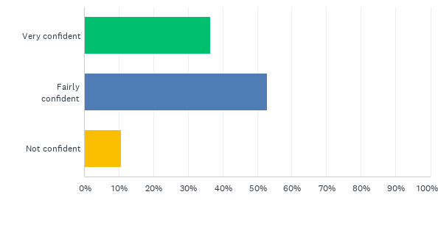
Q12: How confident do you feel with what to do next if the child/family/adult says they don’t want any help but you believe it would benefit them?
Answered: 532 Skipped: 30

Slide 22
Q12: How confident do you feel with what to do next if the child/family/adult says they don’t want any help but you believe it would benefit them?
Answered: 532 Skipped: 30

Slide 23
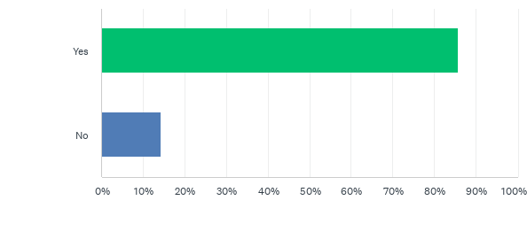
Q13: Do you know who your organisation’s lead officer for safeguarding is and how to contact them?
Answered: 511 Skipped: 51

Slide 24
Q13: Do you know who your organisation’s lead officer for safeguarding is and how to contact them?
Answered: 511 Skipped: 51

Slide 25
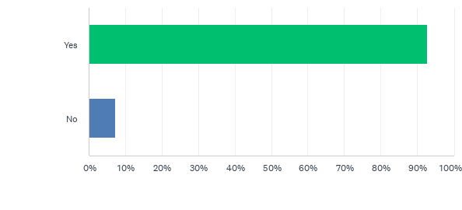
Q14: Do you have the opportunity to reflect on cases with a colleague/manager in a way that supports you in making safeguarding decisions?
Answered: 510 Skipped: 52

Slide 26
Q14: Do you have the opportunity to reflect on cases with a colleague/manager in a way that supports you in making safeguarding decisions?
Answered: 510 Skipped: 52

Slide 27
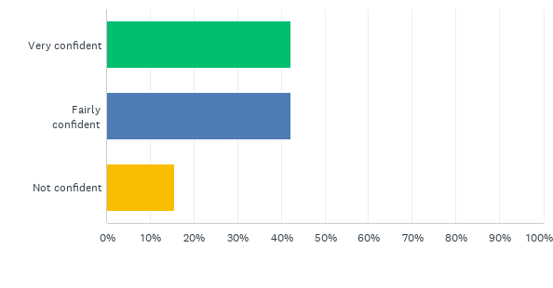
Q15: How confident would you be to escalate issues if you felt that your safeguarding concerns were not being addressed within your organisation or by another organisation you had raised the case to e.g. County Council, Police, etc?
Answered: 512 Skipped: 50

Slide 28
Q15: How confident would you be to escalate issues if you felt that your safeguarding concerns were not being addressed within your organisation or by another organisation you had raised the case to e.g. County Council, Police, etc?
Answered: 512 Skipped: 50

Slide 29
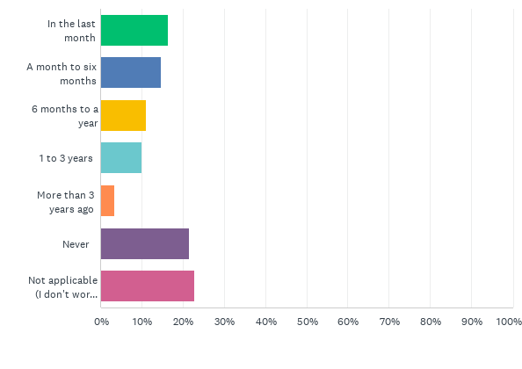
Q16: When did you last look at the Safeguarding Children's Board website/Twitter?
Answered: 511 Skipped: 51

Slide 30
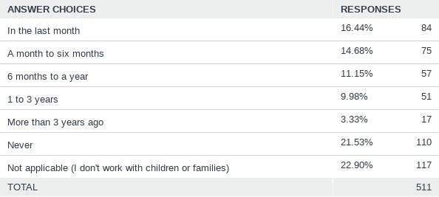
Q16: When did you last look at the Safeguarding Children's Board website/Twitter?
Answered: 511 Skipped: 51

Slide 31
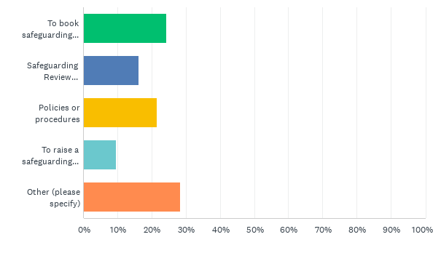
Q17: What were you looking for?
Answered: 375 Skipped: 187

Slide 32
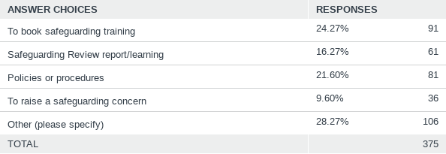
Q17: What were you looking for?
Answered: 375 Skipped: 187

Slide 33
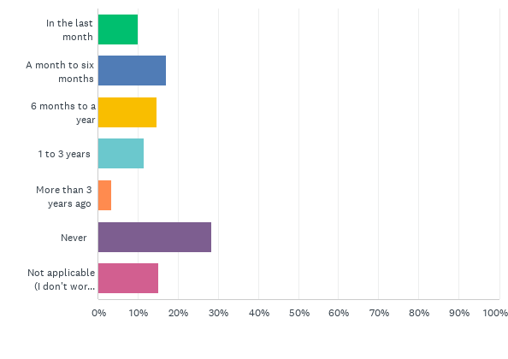
Q18: When did you last look at the Safeguarding Adults Board website/Twitter?
Answered: 506 Skipped: 56

Slide 34
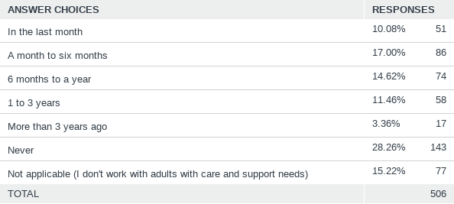
Q18: When did you last look at the Safeguarding Adults Board website/Twitter?
Answered: 506 Skipped: 56

Slide 35
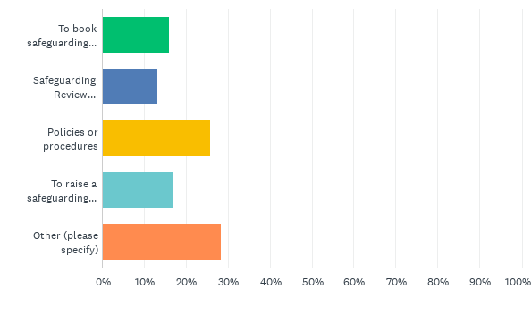
Q19: What were you looking for?
Answered: 364 Skipped: 198

Slide 36
Q19: What were you looking for?
Answered: 364 Skipped: 198

