Slide 1
February 2022 update

Slide 2
Child Safeguarding Practice Reviews
The Serious Case Review for Child R was published in December 2022.
Child R was thirteen years and seven months old when she died in an out of county residential placement. She had previously been in foster care in Oxfordshire and had also been treated in an Oxfordshire in-patient psychiatric unit prior to moving to the residential home. She was part of a large sibling group, who had been supported by services for some time. Safeguarding concerns included neglect, physical harm and sexual harm.
Here are the links to the Report and Learning summary
Rapid Reviews
A multi-agency chronology can provide a good insight into ‘what it means to be a child in this family’ and we should try and use it more as a partnership.
When working with a large family group, the recording of how and why decisions are made is crucial. This supports multi-agency working and helps to make it clear where progress is being made by the family to keep their children safe and well.
When working with many different agencies to support a large family check the gaps in information or discrepancies e.g. ensure there is a record of decision-making, follow up on missing reports and assessments from partner agency files, complete gaps in family details

Slide 3
The ‘Threshold of needs’ has been updated:
This provides advice on :
What to do and When, to ensure that children and families get the right support at the right time
Notes:
In 2020-21 the OSCB completed 8 ‘serious incidents’ for a ‘Rapid Review’ and 1 case of concern. This led to 2 CSPR and 1 local Partnership learning review.
Learning points from the last 12 months:
Maintain face to face contacts where possible
Ensure that professionals maintain good contact with each other when making decisions on risk
Think about the whole family e.g. share information across different parts of the health service
Safeguarding risks on co-sleeping should be explained to both parents
Look for ‘reachable moments in adolescent children’s lives’
Children are safer when they are in education
In 2020-21 the OSCB worked on ten reviews. Some of the reviews started before 2020. They concerned twelve children. Four were female and six were male.
Two reviews were published: Child K and the Jacob CSPR. They had local and national recommendations which are detailed in full in both reports.
In two of the three reviews on children under 5 years the child suffered physical abuse.
In three of the reviews on adolescent young people, mental wellbeing and suicidal behaviours were contributory factors.
Sadly, two of the reviews concerned children who are deceased.

Slide 4
Child exploitation
We have developed a simple Case Study Template to gather examples of good practice of where ‘working- together-across-agencies’ has improved the situation for children at risk of exploitation.
Practitioners are invited to complete the form to highlight examples of partnership work undertaken with children and young people at risk of or involved in any form of exploitation, to where you have made a difference.
Completed forms should be sent to: OSCB@Oxfordshire.gov.uk
If you or a colleague have any concerns around exploitation of a child or young person, please continue to use the existing screening tool and pathway, see below:
Child Exploitation Screening Tool
Safeguarding Children at Risk of Exploitation Partnership Response
The Independent Inquiry into Child Sexual Abuse have published an Investigation Report into child sexual exploitation by organised networks, February 2022. The investigation focuses on the nature and extent of, and institutional responses to, sexual exploitation of children by organised networks.
Notes:
Senior multi-agency representatives have taken part in two workshops, to develop a shared vision and approach for our work to safeguard adolescents from exploitation and ensure that they feel safe in their communities. The group has now begun to consider what could help equip multi-agency practitioners, managers, and strategic leaders across the partnership to work in this way, and importantly, how we might capture progress and the impact of what we do. We will begin to share this work more widely across the system in the New Year – so do watch out for the next update.

Slide 5
Safeguarding Campaigns
Sudden unexpected death in infancy:
National panel review
National campaigns shared locally
Lullaby Trust: Safer Sleep guidance and resources
NHS: Lift the Baby campaign
Awareness raising of the risks around co-sleeping with both parents/carers
Put them on their BACK for every sleep
In a CLEAR, FLAT SLEEP SPACE
Keep them SMOKE FREE day and night
Never sleep with baby on a sofa or armchair

Slide 6
Safeguarding Training
Upcoming training:
Introduction to Domestic Abuse - Tues 1/3 (09:30 - 12:30)
Understanding Child Exploitation: Part 2 - Thurs 3/3 (9:30 - 12:30)
Impact of Domestic Abuse on Children and Families - Fri 4/3 (09:30 - 12:30)
Domestic Abuse and Young People - Wed 9/3 (10:00 - 13:00)
Working with fathers and other male carers- Wed 16/3 (09:30 - 13:00)
Designated Safeguarding Lead - Tues 22/3 (09:30 - 11:30)
Drugs and Alcohol - Increasing Knowledge / Reducing Risk - Thurs 24/3 (09:30 - 13:00)
Visit www.training.oscb.org.uk for further dates, info and bookings

Slide 7
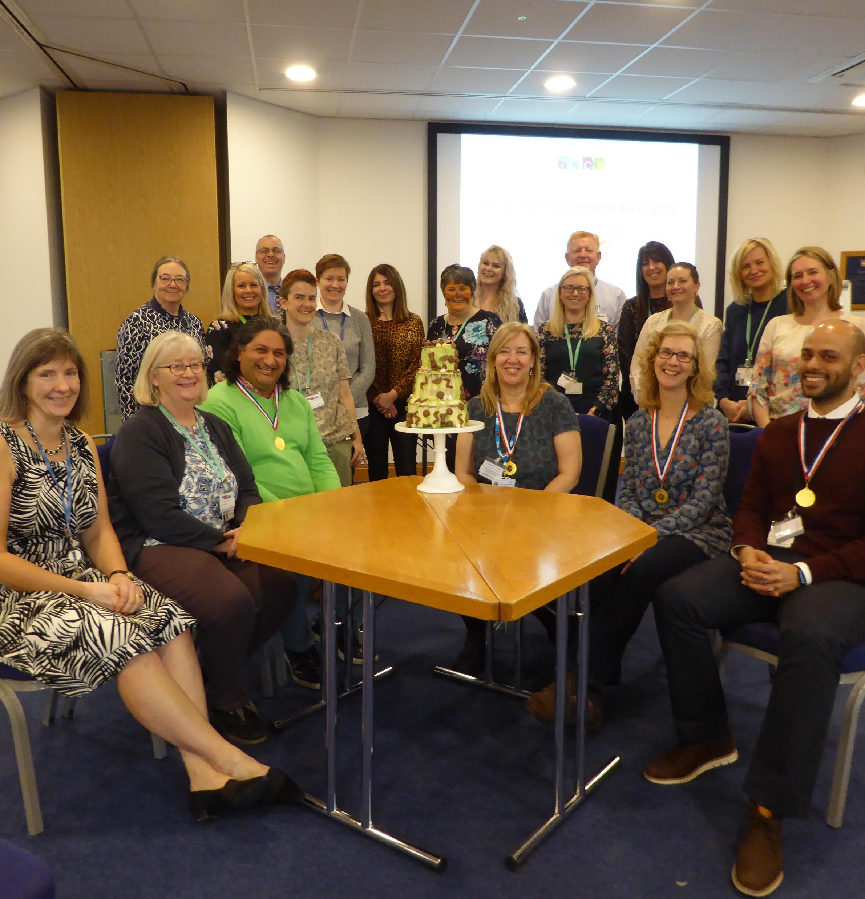
Looking for a new challenge?
…. become a member of the OSCB Training Pool
The OSCB deliver training to approximately 5000 practitioners a year. The Training Pool was highly commended in the NSPCC/BASPCAN ‘Trainer of the Year Award’ 2018 (coming 4th from over 100 nominations)!
We are currently looking for additional trainers to join us, a few of the benefits are:
opportunities to network with multi-agency practitioners
fantastic support from the OSCB training team, including a variety of trainer development sessions
input into course development and access to training materials to deliver sessions to your own organisation
an annual trainer celebration event
priority booking on OSCB Conferences and Learning Events
For further information or to register your interest, please email Gay Suggitt @ oscb.training@oxfordshire.gov.uk

