Slide 1
Neglect strategy Early Help November Update Phase 1. Ensure that there is a cultural shift across universal services so that Early Help Assessments continue to be developed as a helpful multi-agency tool to use to understand a family’s story/provision of support services and that there are clear messages as to how an Early Help Assessment can help them.
Maria Godfrey – Early Help Strategic Lead, OCC

Slide 2
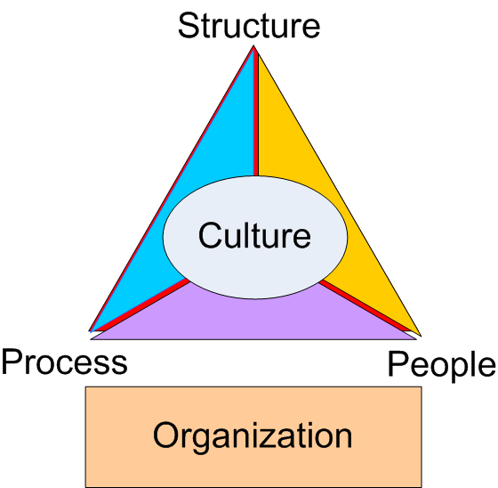
Cultural shift required
Data indicates low numbers of Early Help Assessments amongst some partners
Partnership review identified barriers:
Some practitioners view the Early Help Assessment as a cumbersome tool, to be used as a referral mechanism to access Children’s Social care
Practitioners report lack of clarity about when to use early help assessment processes
Lack of confidence on the part of some staff to engage with families around difficult issues
Capacity to carry out EHAs in addition to high caseloads
Strategic and operational support required
WHAT
WHEN
HOW
Notes:
Learning review evidencing severe neglect of two children could have been prevented if threshold need guidance had been understood and Early Help provided
Ensure that there is a cultural shift across universal services so that Early Help Assessments continue to be developed as a helpful multi-agency tool to use to understand a family’s story/provision of support services and that there are clear messages as to how an Early Help Assessment can help them.
Set up a multi agency Early Help Assessment Task and Finish Group to carry out a multi-agency review, take stock of where we are, identify what is going well and what are the challenges that need to be addressed to achieve a position where majority of practitioners use the early help assessment to achieve the above intention
Protecting children from neglect | NSPCC Learning

Slide 3
November Update Actions
Strategy
Strategic expectations set out in Children’s Trust and CEDR performance frameworks to achieve year on increases of EHAs
Senior Lead appointed to provide strategic focus and drive this work forward over the next 12 months.
Joint Working
Multi-agency group are reviewing the EHA form and training
Extended remit of Early Help Networks.
Multi-agency Early Years performance framework and dashboard developed
Additional link-up with Adult Services and Public Health regarding The Oxfordshire Way
Linked with TVP and Children Heard and Seen to complete EHAs
Joint working between Children’s Social Care and SEND: EHA to be incorporated into Early Intervention pathway
Notes:
1 At least 2000 EHAs to be completed in 2021/22
2 At least 200 Early Help assessments should be completed by health visitors in 2021/22
3 To increase number of EHA’s completed to 15000 by 2024/25 and by 2026/27 increase to 28,000 in line with poverty data.
Early years
Monthly Managers and Childminder meetings
LCSS attended to talk about EHA in Feb/March 2021 – this is now a monthly occurrence.
Regular Communications – fortnightly e-newsletter (2000 subscribers), Facebook, termly briefings, virtual visits on EHA by the Early Years team.
Annual safeguarding audit sent to 700 EY providers (And for first time) – specific questions on completion of EHA & contact with LCSS
Going virtual with EHA training for EY providers – greater reach, evening sessions, increased number of places
48% of settings said they had contacted LCSS in past year and 26% had completed an EHA
Numbers attending evening training up from 34 in Summer 2019 to 119 in Summer 2021
SEND
Information about use of EHA’s added into all of Early Years SEND training.
The message is that the graduated response is necessary for all children with SEND and for some children an EHA will need to be part of that graduated response.
EY SEN team offer ‘no names’ discussions for early years settings who to consider what action to take for children with emerging SEND. If relevant these discussions will include consideration of an EHA.
Information about the Graduated Response to be added to Help Assessment training to ensure settings get the same messages
LCSS have attended EYSEN Team meeting to ensure all staff have a comprehensive understanding of Early Help and the role of LCSS.
If EYSEN team member becomes aware that a setting is struggling to complete an EHA with a family; the team member will discuss contact with LCSS so that LCSS can offer support
Trained whole HV service inc NN
144 PCSOs trained across Ox this year

Slide 4
Actions continued…
Training
Restorative Practice training has been delivered to 10 secondary schools and 32 primaries during 2020/21
Attendance and exclusions training with schools via Attendance Network meetings and In Year Fair Access Panels advocates for use of EHAs
Bespoke Early Help training delivered to Early Years services, Police and Health Visitor service
Education training has been delivered to 150+ CSC staff and managers
Also…
Pathway for parents with additional needs developed and rolled out
LCSS and LADO service piloted 1:1 supervision for education staff
Neglect audit tool and action plans for schools developed
Threshold of Need document has been updated
Plan to increase online resources for practitioners and families
EHAs as part of support offered to Universal Partnership Plus families (higher level of vulnerability)
Attendance Officers have been delivering door knocks and prevention case work during the pandemic to sight children deemed vulnerable when not attending school.
Notes:
TON provides greater clarity on when universal services should use early help processes to support families.
Pathway underpinned by TON Joint training for adult and Training to adult and children services
to ensure consistent messages about thresholds
Neglect audit tool developed by schools to identify neglect early being monitored through annual S157/175 return.
Anecdotal and data indicates that, as a result, staff are more confident in initiating difficult conversations and identifying neglect as an issue
monthly consultations ,joint training attendance at TAF meetings
Comment from Rachel Weston’s email:
Staff at John Henry Newman Academy were surveyed in July 2020 before training on Neglect was in place. A follow up survey was then conducted in September 2020 after the staff completed the Level 2 Awareness of Abuse and Neglect course. The survey contained some mis-information about what neglect is alongside true examples of types of neglect.
The survey in September 2020 showed an improvement in Knowledge and Understanding of Neglect. A few examples were (refer to table):
Neglect is…. Pre-training July 2020 Post training September 2020
Failure to provide an education 0% 87%
Being unresponsive to a child’s emotional needs 94% 100%
Failure to provide enriching experiences 46% 27%
Failure to protect a child from physical and emotional harm or danger 96% 100%

Slide 5
Impact
Year on year increases in completion of Early Help Assessments and increased TAF processes.
* This gives a trajectory of around 3000 EHAs for 2021/22
Increase in early years EHAs
Increase in Children supported at Early Help Preventative level:
1103 Children currently supported by LCSS
2635 Children currently supported through Community TAFs (led by partners)
3738 Total Children being supported at Early Help Preventative level
 | 2017/18 | 2018/19 | 2019/20 | 2020/21 | Apr 2021 to Oct 2022 *
Total EHA's | 1233 | 1480 | 1935 | 1825 | 1708
Notes:
Oxfordshire -year on year increases in completion of Early Help Assessments (dip 2020 due to covid) however despite this since Jan 2021 there has been an increase on 2020 figure and are already nearing the overall total of 2019.
Increased number of EHA’s from pre schools/nurseries: March –
EYS in 2020 EHA numbers = 28, to date 2021 = 44 total
HV in 2020 EHA = 44, to date in 2021 = 68
Confidence
High numbers aware of support that LCSS can offer (LCSS –EY Survey /OSCB Survey to be repeated annually)
by universal partners about when to use and how to engage families in Early help processes. (all above 85% in terms of knowing LCSS and EH)
Planned survey to agencies that have had bespoke training to ascertain confidence levels
CIN cases with EHA’s increasing still work to do on Child protection cases. Work in progress.

Slide 6
Impact continued…
Close working between Education and Children’s Social Care on early intervention and prevention has avoided 282 permanent exclusions during 2019-21
Restorative practice has resulted in a decrease in persistent absence and suspensions
Year | Total PEX | Early intervention
2019/2020 | 66 | No data
2020/2021 | 19 | 282
Reduction in Persistent Absence:
237.97 (Spring 2020) to 71.41 (Spring 2021)
Reduction in Suspensions:
14.74 (Spring 2020) to 3.86 (Spring 2021)
Notes:
Oxfordshire -year on year increases in completion of Early Help Assessments (dip 2020 due to covid) however despite this since Jan 2021 there has been an increase on 2020 figure and are already nearing the overall total of 2019.
Increased number of EHA’s from pre schools/nurseries: March –
EYS in 2020 EHA numbers = 28, to date 2021 = 44 total
HV in 2020 EHA = 44, to date in 2021 = 68
Confidence
High numbers aware of support that LCSS can offer (LCSS –EY Survey /OSCB Survey to be repeated annually)
by universal partners about when to use and how to engage families in Early help processes. (all above 85% in terms of knowing LCSS and EH)
Planned survey to agencies that have had bespoke training to ascertain confidence levels
CIN cases with EHA’s increasing still work to do on Child protection cases. Work in progress.

Slide 7
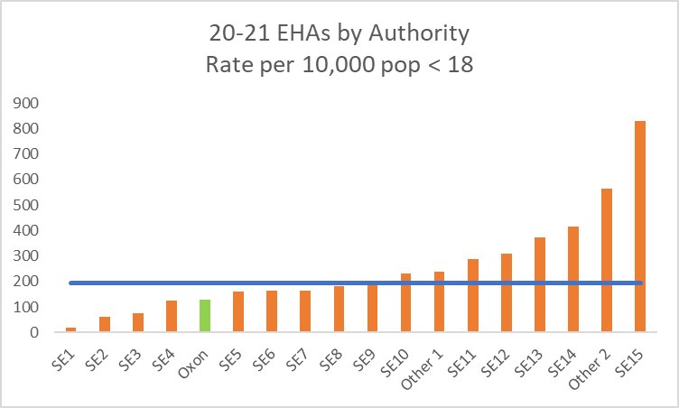
Next Steps
Putting this progress into context
Children & families should receive least intrusive early help support as soon as problems emerge to help them continue to develop and thrive. We are making good progress on this, however…
Over the last 5 years we have averaged over 6000 social care assessments per annum, compared to only 1600 early help assessments (2017-2021)
While there is no national data on EHAs we are a member of a SE Data Benchmarking club
The highest performing authority would have over 12000 EHAs if they had the same population size as Oxfordshire
Strategic conversation at Childrens Trust 2nd December to discuss with partners further cultural shift to increase numbers further of EHA’s

Slide 8
Phase Two
Phase two
Address high levels of school absence/exclusions for children identified as suffering from neglect
Head of Learner Engagement to chair next EH T&F group looking specifically at why high numbers of children with high levels of school absence/exclusions for children identified as suffering from neglect.
Meeting 14th December 2021

